Slide 1


Slide 2
Contents
Introduction
Benefits of Generics
Generic Classes and Interfaces
Generic Methods

Slide 3
Introduction
Enables to create classes, interfaces, and methods in which the type of data upon which they operate is specified as a parameter.
Introduced in Java by jdk 1.5.
Generics means parameterized types.
Generics add the type-safety.
Generics add stability to your code by making more of your bugs detectable at compile time.

Slide 4
Why Generics?
The functionality of Gen class can be achieved without generics by specifying Object type and using proper casting whenever required.
Then why we use Generics?
Java compiler does not have knowledge about the type of data actually stored in NonGen. So-
Explicit casts must be employed to retrieve the stored data.
Several type mismatch errors cannot be found until run time.

Slide 5
Why Generics?
Stronger type checks at compile time
Elimination of casts
List list = new ArrayList(); list.add("hello");
String s = (String) list.get(0);
Using generics:
List<String> list = new ArrayList<String>(); list.add("hello");
String s = list.get(0); // no cast
Enabling programmers to implement generic algorithms.
We can implement generic algorithms that work on collections of different types, can be customized, and are type safe and easier to read.

Slide 6
Advantage of Generics
The ability to create type-safe code in which type-mismatch errors are caught at compile time is a key advantage of generics.

Slide 7
Example
class Gen<T> {
T ob;
Gen(T o)
{
ob = o;
}
T getob()
{
return ob;
}
void showType()
{
System.out.println("Type of T is " + ob.getClass().getName());
}
}

Slide 8
class GenDemo {
public static void main(String args[]) {
Gen<Integer> iOb;
iOb = new Gen<Integer>(88);
iOb.showType();
int v = iOb.getob();
System.out.println("value: " + v);
Gen<String> strOb = new Gen<String>("Generics Test");
strOb.showType();
String str = strOb.getob();
System.out.println("value: " + str);
} }

Slide 9
Generics Work Only with Objects
When declaring an instance of a generic type, the type argument passed to the type parameter must be a class type.
Gen<int> strOb = new Gen<int>(53);
The above declaration is an error.
A reference of one specific version of a generic type is not type compatible with another version of the same generic type.
iOb = strOb; // Wrong!

Slide 10
Generic Class

Slide 11
General Form of Generic Class
The generics syntax for declaring a generic class:
class class-name<type-param-list>
{ // ... }
The syntax for declaring a reference to a generic class:
class-name<type-arg-list> var-name =
new class-name<type-arg-list>(cons-arg-list);

Slide 12
Generic Class with Multiple Type Parameters
class TwoGen<T, V> {
T ob1; V ob2;
TwoGen(T o1, V o2) {
ob1 = o1; ob2 = o2; }
void showTypes() {
System.out.println("Type of T is " + ob1.getClass());
System.out.println("Type of V is " +
ob2.getClass()); }
T getob1() { return ob1; }
V getob2() { return ob2; }
}

Slide 13
class SimpGen {
public static void main(String args[]) {
TwoGen<Integer, String> t =
new TwoGen<Integer, String>(123, "Testing Two Parameter");
t.showTypes();
int v = t.getob1();
System.out.println("value: " + v);
String str = t.getob2();
System.out.println("value: " + str);
}
}

Slide 14
Problem
Create a generic class that contains a method that returns the average of an array of numbers of any type, including integers, floats, and doubles.

Slide 15
Possible Solution
class Stats<T> {
T[] nums;
Stats(T[] o) {
nums = o;
}
double average() {
double sum = 0.0;
for(int i=0; i < nums.length; i++)
sum += nums[i].doubleValue(); // Error!!!
return sum / nums.length;
}
}

Slide 16
Why Error?
The compiler has no way to know that you are intending to create Stats objects using only numeric types.
When we try to compile Stats, an error is reported that indicates that the doubleValue( ) method is unknown.
We need some way to tell the compiler that we intend to pass only numeric types to T.

Slide 17
Bounded Types
Used to limit the types that can be passed to a type parameter.
When specifying a type parameter, we can create an upper bound that declares the super-class from which all type arguments must be derived.
<T extends superclass>
A bound can include both a class type and one or more interfaces.
class Gen<T extends MyClass & MyInterface>
Any type argument passed to T must be a subclass of MyClass and implement MyInterface.

Slide 18
WILD CARD GenericS

Slide 19
Problem
Create a generic class that contains a method sameAvg( ) that determines if two Stats objects contain arrays that yield the same average, no matter what type of numeric data each object holds.
For example, if one object contains the double values 1.0, 2.0, and 3.0, and the other object contains the integer values 2, 1, and 3, then the averages will be the same.

Slide 20
Possible Solution
Integer inums[] = { 1, 2, 3, 4 }; Double dnums[] = { 1.1, 2.2, 3.3, 4.4 };
Stats<Integer> iob = new Stats<Integer>(inums);
Stats<Double> dob = new Stats<Double>(dnums);
if(iob.sameAvg(dob))
System.out.println("Averages are the same.");
else
System.out.println("Averages differ.");
boolean same_Avg(Stats<T> ob)
{
if(average() == ob.average())
return true;
return false;
}

Slide 21
Why Error?
It will work only with the objects of same type.
if the invoking object is of type Stats<Integer>, then the parameter ob must also be of type Stats<Integer>.

Slide 22
WildCard Argument
The wildcard simply matches the validity of object.
The wildcard argument is specified by the ?, and it represents an unknown type.
boolean same_Avg(Stats<?> ob)
{
if(average() == ob.average())
return true;
return false;
}
.
Here, Stats<?> matches any Stats object, allowing any two Stats objects to have their averages compared

Slide 23
Generic Method

Slide 24
Generic Method
It is possible to declare a generic method that uses one or more type parameters.
Methods inside a generic class are automatically generic relative to the type parameters.
It is possible to create a generic method that is enclosed within a non-generic class.

Slide 25
Generic Methods
The type parameters are declared before the return type of the method.
Generic methods can be either static or non-static.
<type-param-list> ret-type method-name(param-list) {…}
Example:
static <T, V extends T> boolean isIn (T x, V[] y)
This ability to enforce type safety is one of the most important advantages of generic methods.

Slide 26
Generic Constructors

Slide 27
Generic Constructors
It is possible for constructors to be generic, even if their class is not.
Example:
class GenCons
{
private double val;
<T extends Number> GenCons(T arg)
{
val = arg.doubleValue();
}
}
}

Slide 28
// Use a generic constructor.
class GenCons {
private double val;
<T extends Number> GenCons(T arg) {
val = arg.doubleValue();
}
void showval() {
System.out.println("val: " + val);
}
}
class GenConsDemo {
public static void main(String args[]) {
GenCons test = new GenCons(100);
GenCons test2 = new GenCons(123.5F);
test.showval();
test2.showval();
}
}
Note: Because GenCons( ) specifies a parameter of a generic type, which must be a subclass of Number, GenCons( ) can be called with any numeric type, including Integer, Float, or Double.

Slide 29
Java Collections FrameWork

Slide 30
A data structure is a collection of data organized in some fashion. The structure not only stores data but also supports operations for accessing and manipulating the data.
Java provides various data structures that can be used to organize and manipulate data efficiently. These data
structures are commonly known as Java Collections Framework.
In object-oriented thinking, a data structure, also known as a container, is an object that stores other objects, referred to as data or elements.

Slide 31
The Java Collections Framework supports two types of containers:
■ One for storing a collection of elements, simply called a collection.
■ The other for storing key/value pairs, called a map
Maps are efficient data structures for fast searching an element using a key
The Java Collections Framework supports three major types of collections: Set, List, and Queue.
An instance of Set stores a group of nonduplicate elements.
An instance of List stores an ordered collection of elements.
An instance of Queue stores objects that are processed in first-in, first-out fashion.

Slide 32
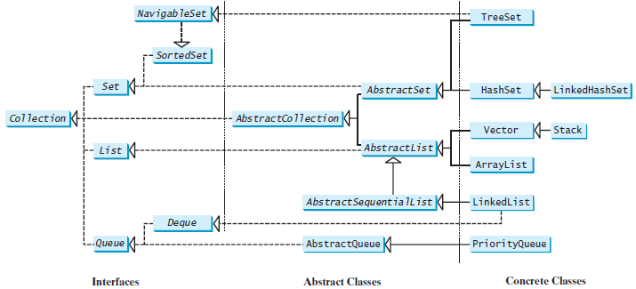
Collection
All the concrete classes in the Java Collections Framework implement the java.lang. Cloneable and java.io. Serializable interfaces. Thus their instances can be cloned and serialized.

Slide 33
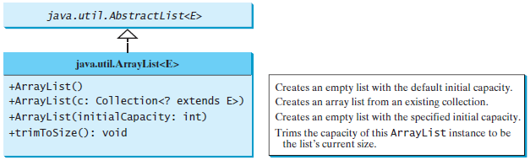
The ArrayList Classes

Slide 34
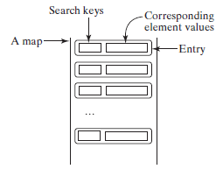
Maps
Optimizes Searching.
A map is a container that stores the elements along with the keys.
The keys are like indexes.
In Map, the keys can be any objects. A map cannot contain duplicate keys. Each key maps to one value. A key and its corresponding value form an entry, which is actually stored in a map.

Slide 35
There are three types of maps: HashMap, LinkedHashMap, and TreeMap.
The common features of these maps are defined in the Map interface.
The Map interface provides the methods for querying, updating, and obtaining a collection of values and a set of keys

Slide 36
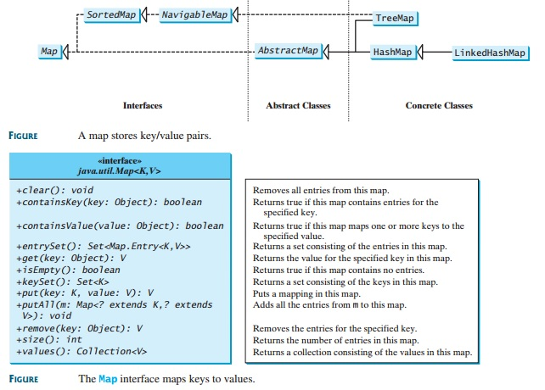

Slide 37
HashMap class
The HashMap class is efficient for locating a value, inserting a mapping, and deleting a mapping.

Slide 38


